Slide 2
Assignment 2 - Aleph & Popper
Group 2 - Giovanni Filomeno, Manu Gupta, Sarah Lackner

Slide 3
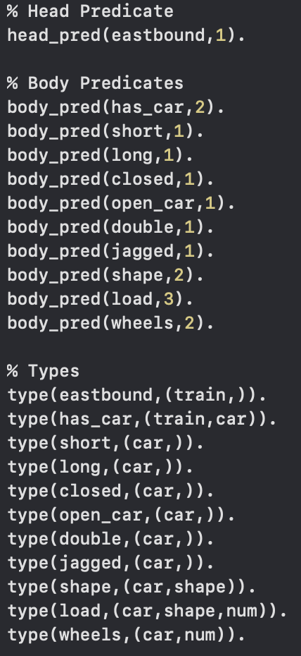
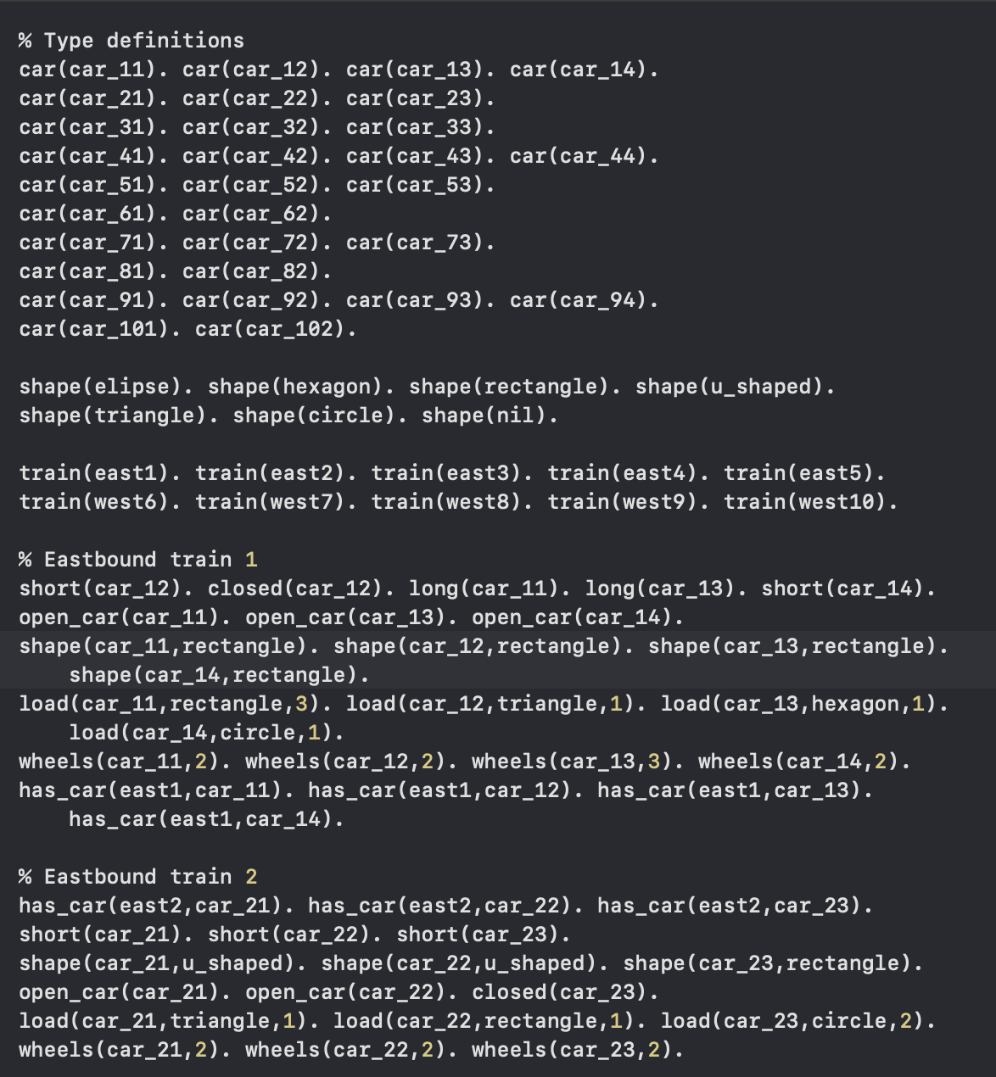
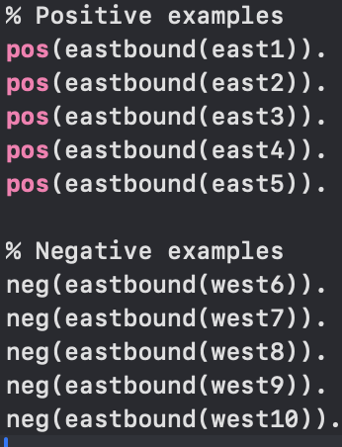
Exercise 1 - Encoding with Popper (Train Problem)
bias.pl: Defines head and body predicates, their types,
bk.pl: background knowledge
exs.pl

Slide 4
Exercise 1 - Results and Comparative Analysis - Train Problem
Aleph's Solution:
Output: eastbound(A) :- has_car(A, B), short(B), closed(B).
Accuracy: 100%
Clauses Constructed: 70
Time Taken: 0.011 seconds
Popper's Solution:
Output: eastbound(V0):- has_car(V0, V1), short(V1), closed(V1).
Accuracy: 100%
Programs Generated: 46
Time Taken: 0.17 seconds
Comparative Analysis:
Aleph generated more clauses faster but was less efficient in terms of hypothesis evaluation.
Popper generated fewer programs but took longer due to iterative refinement.
Both achieved the same final rule and accuracy, demonstrating effective learning.

Slide 5
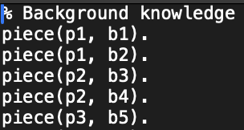
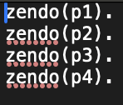
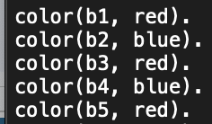
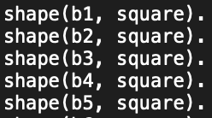
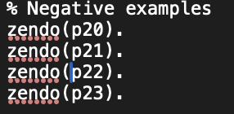
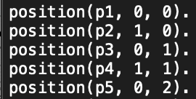
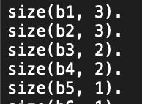
Exercise 1 - Encoding with Aleph (Zendo Game)
zendo.b: background knowledge
zendo.f, zendo.n: positive and negative examples

Slide 6
Exercise 1 - Results and Comparative Analysis - Zendo Game
Aleph's Solution:
Generated overly specific rules for each positive example.
Accuracy: 100%
Total Clauses Constructed: 0
Time Taken: 0.0021 seconds
Popper's Solution:
Output: zendo(V0):- small(V2), piece(V0, V1), red(V1), contact(V1, V3), size(V3, V2).
Accuracy: 100%
Programs Generated: 1412
Time Taken: 0.71 seconds
Comparative Analysis:
Aleph’s rules were specific to individual examples, leading to less generalization.
Popper produced a complex and generalized hypothesis covering all examples.
Despite the longer runtime, Popper’s rules were more robust and interpretable.

Slide 7
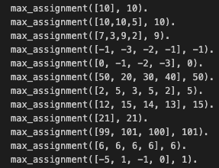
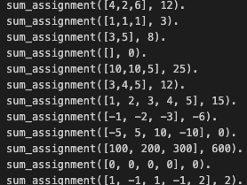
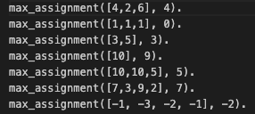
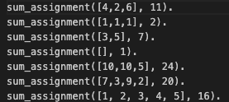
Exercise 2 - Encode with Aleph and Popper
The second exercise is about encoding with Aleph and Popper two recursive example. We decided to go for sum and max.
On the right side, there are the positive and negative example for Aleph.

Slide 8
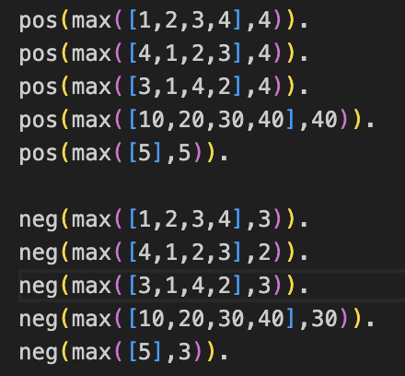
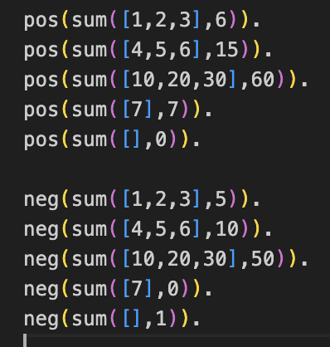
Exercise 2 - Encode with Aleph and Popper
Similarly, the positive and negative examples for Popper were written

Slide 9


Exercise 2 - Aleph Results

Slide 10
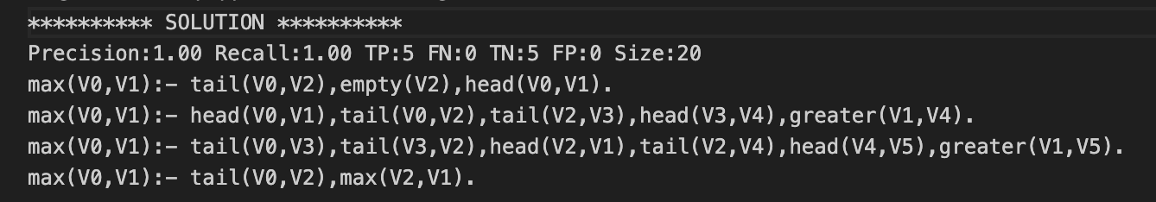
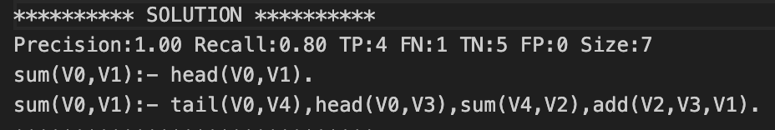
Exercise 2 - Popper Results

Slide 11
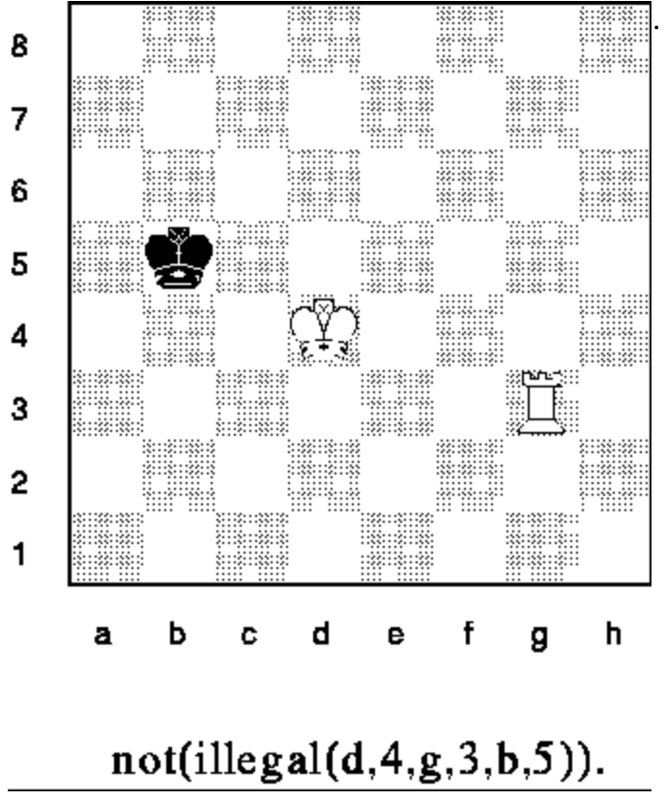
Exercise 3 - KRK Chess
King-Rook-King endgame
Illegal positions
Pieces having the same position
Black king in check
Kings adjacent to each other
Aleph: illegal(A,B,C,D,E,F)
Popper: illegal(V0,V1,V2,V3,V4,V5)
→ illegal(colWK, rowWK, colWR, rowWR, colBK, rowBK)
Notes:
Exercise 3 we chose the King-Rook-King endgame from the examples of the website. Illegal position are …
First of all we encoded the target predicate illegal where the first entry represent the column of the White King, then the row of the White King, same for White Rook and Black King. Aleph and Popper introduce different variables for this in their encoding
On the image one can see a legal position of the pieces in the krk endgame.

Slide 12
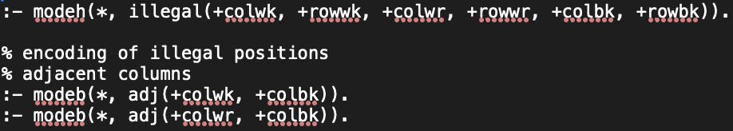
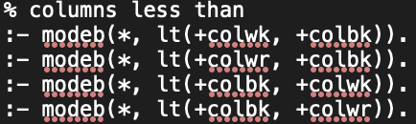
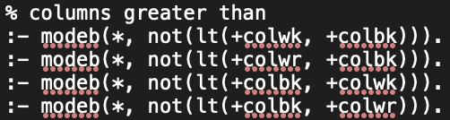

Exercise 3 - Aleph
Mode declaration:
Additional predicates:
Notes:
This is just an excerpt of the whole encoding due to the similarity of the mode declarations, we didn’t include everything. Every mode declaration encoded for the columns is also encoded for the rows.
In order to check for pieces having the same position we encoded 2 additional predicates.

Slide 13
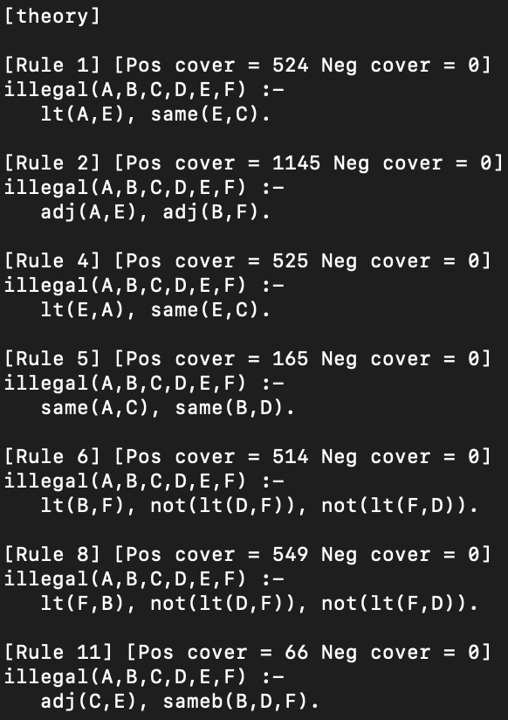
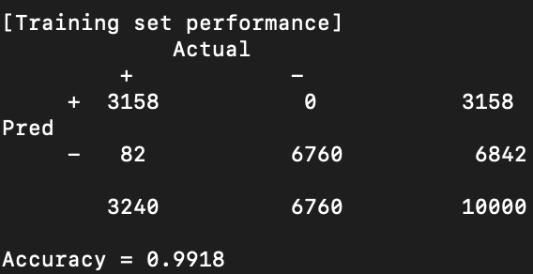
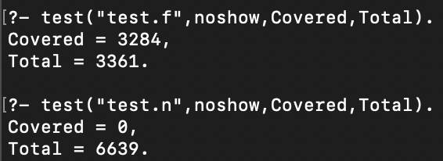
Exercise 3 - Aleph
Rule set:
Results:
Notes:
On the RHS one can see the learned rules. For example the 1st rule encodes that we’ve an illegal position if column of the WK is less than the column of the Black King and the Row of the White Rook is the same as the on of the Black King. Meaning the BK would be in chess by the WR and is therefore an illegal move.
On the LHS are the results on the training set and test sets respectively.

Slide 14
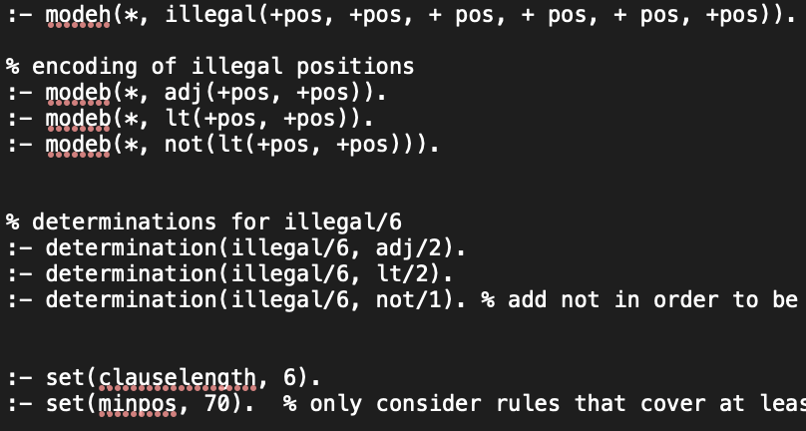
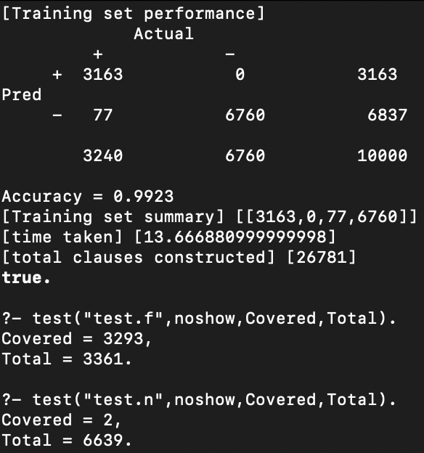
Exercise 3 - Aleph simplified
11 rules in rule set
Notes:
During the encoding for Popper we realized that we also could simplify the encoding of Aleph. Here we just want to show a quick summary of the results from simplified version. The accuracy is slightly less and for the test set we also cover False Negatives. Hence, we sticked to our more complex implementation as a final result.

Slide 15
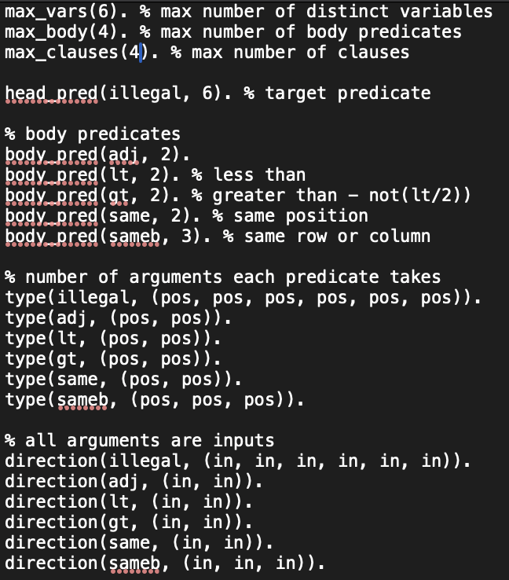
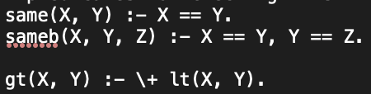
Exercise 3 - Popper
same/2, sameb/3 equivalent to Aleph
gt/2 equivalent to not(lt/2))
bk.pl
bias.pl

Slide 16
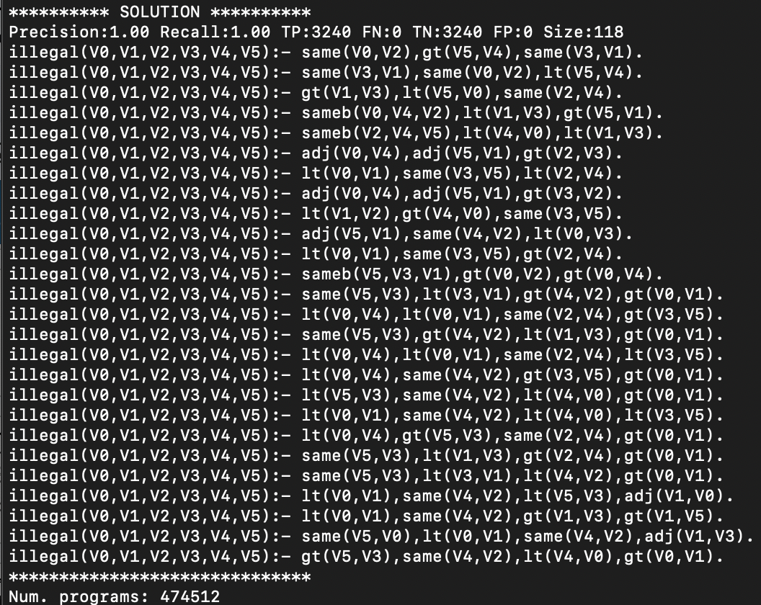
Exercise 3 - Popper
26 Rules
No Misclassifications
Complex
long running time (20 min)
Notes:
The Popper rule set consists of 26 rules …

Slide 17
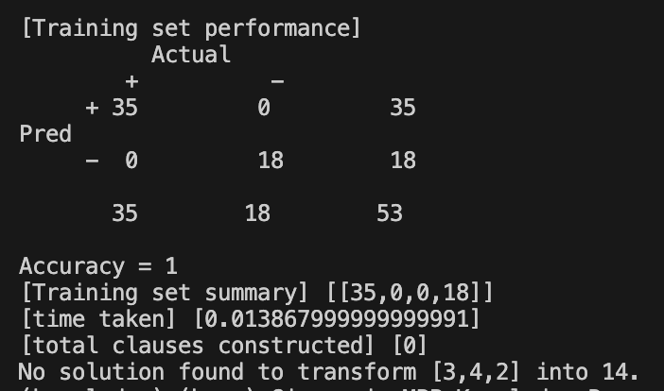
Exercise 4 - Bonus
For exercise 4, we tried to encode with Aleph the operator exercise presented in the first assignment. Unfortunately, even with a huge amount of training example, the program seems not to be able to perform the calculation

Slide 18
Conclusion and Insights
Aleph:
Excels in speed and simplicity.
Suitable for quick hypothesis generation.
Popper:
Offers detailed and complex rule generation.
Better for complex problems requiring deeper rule induction.
Insights:
Both systems are effective in their domains.
Choice depends on task complexity and need for generalization.
Understanding each system's strengths and limitations is crucial for selecting the appropriate tool for specific learning tasks.

Slide 19
Thank you for your attention!

Slide 20
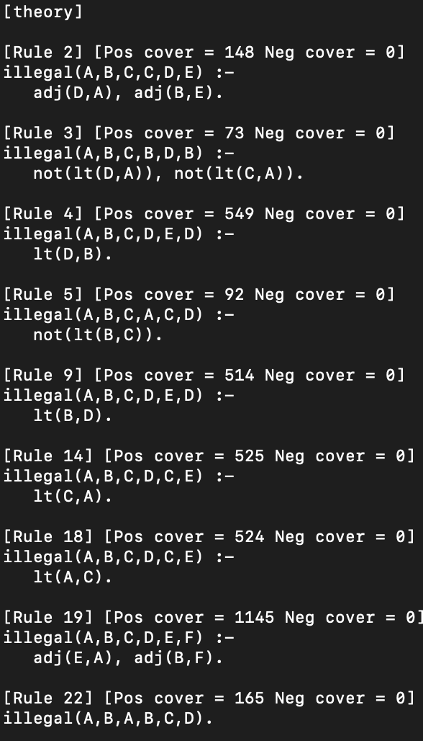
Exercise 3 - Aleph simplified
Ruleset:
Notes:
ONLY IF ASKED

